Slide 1
Interactive Time-Series Visualizations
NASA Goddard space flight center summer 2010 internship
Shawn doria

Slide 2
Goal
To research and create a
interactive and general purpose
time-series graph for the web in
JavaScript.

Slide 3
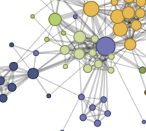
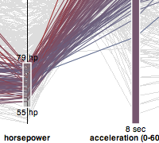

Content
Background
Work Description
What I Did
Results
Conclusion

Slide 4
About Me
Shawn Doria
University of Pennsylvania
Computer Information Science
CCMC – Community Coordinated Modeling Center
David Berrios

Slide 5
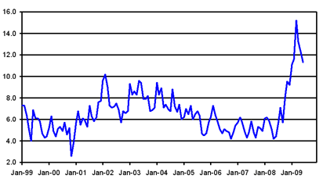
Time-Series Graph?
A time-series graph is a line graph where time is measured on the horizontal axis and the variable being observed is measured on the vertical axis.

Slide 6
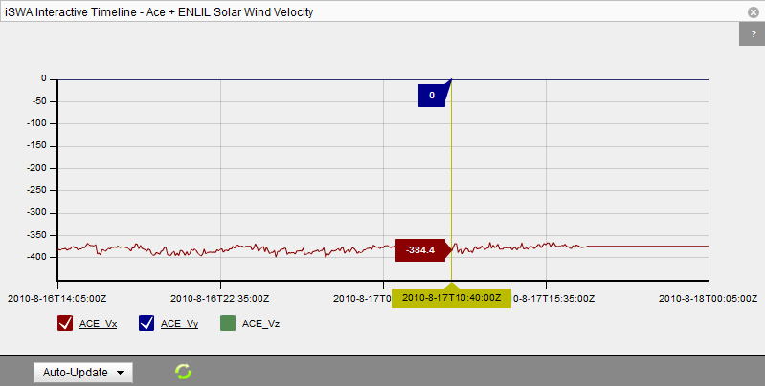
The Problem
CCMC provides time-series graph of its space weather observation on its iSWA (iNTEGRATED SPACE WEATHER ANALYSIS SYSTEM ) website.
Currently the graphs are created using Flash
It’s not convenient
Needs to install Flash
No XML
Interaction issues

Slide 7
Solution
The fix? Create the graphs using cross-browser JavaScript
Speed
Browsers natively support JavaScript
Easy to develop, ship, and maintain
Requirements
JavaScript
Supports JSON (JavaScript Object
Notation)
Interactive
Free (or a non-restrictive license)
Cross-platform
Needs to look good

Slide 8
Research
Many visualization-oriented JavaScript Libraries
 | Native JSON Support | Cost/License | Ease of Dev/Use | Support/ Community | Result
Protovis | Yes (+2) | Free/BSD (+2) | Medium (+1) | High (+2) | 7
Hicharts | Yes (+2) | Pay/Private (+0) | Easy (+2) | Medium (+1) | 5
Digraph | No (+0) | Free/? (+1) | Easy (+2) | Low (+0) | 3
Raphaël | Yes with hack (+1) | Free/MIT (+2) | Medium (+1) | Medium (+1) | 5
Processing.js | Yes with hack (+1) | Free/MIT (+2) | Medium (+1) | High (+2) | 6

Slide 9
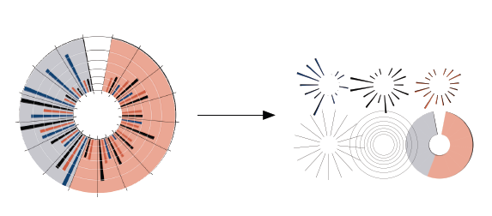
Protovis
Protovis is a JavaScript visualization library developed by the Stanford Visualization Group
Customizable, gives low level control
Simple syntax
Google Group with fast support and Q&A
Looks good!

Slide 10
Rest of the Summer…
…were spent learning the Protovis syntax/API and then agonizingly debugging JavaScript errors.
The result?

Slide 11
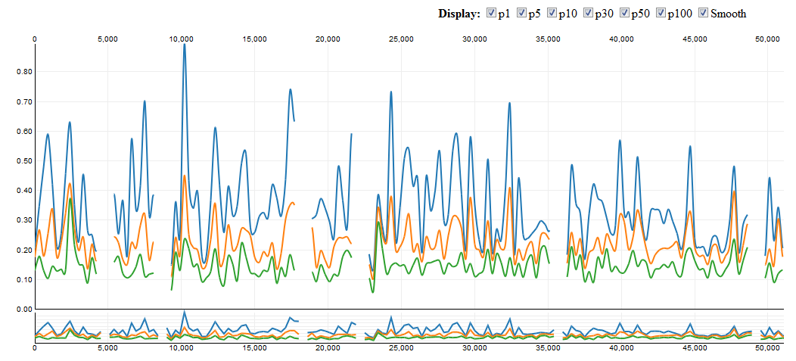
Result

Slide 12
Special Thanks
David Berrios
CCMS
Stanford Visualization Group
Cori Quirk

Slide 13

Questions?

